Slide 1
WINE QUALITY PREDICTION
CHARVEE SARAIYA B220
TANUSH BANCHHOD B228
PRAVEEN KUMAR B234

Slide 2
CONTENTS
INTRODUCTION
OBJECTIVE
INFORMATION ABOUT DATASET
LIBRARIES USED
DATA PRE PROCESSING
DATA VISUALIZATION
MODELS TESTED
APPLYING RANDOM FOREST MODEL
PREDICTING SCORE FROM FEATURES

Slide 3
INTRODUCTION
About wine:
Wine is a beverage made from fermented grape and other fruit juices with lower amount
of alcohol content. Quality of wine is graded based on the taste of wine and vintage. This process is time taking, costly and not efficient.
A wine itself includes different parameters like fixed acidity, volatile acidity, citric acid,
residual sugar, chlorides, free sulphur dioxide, total sulphur dioxide, density, pH,
sulphates, alcohol and quality.
Problem statement:
In industries, understanding the demands of wine safety testing can be a complex task
for the laboratory with numerous analytes and residues to monitor.
But, our application’s prediction, provide ideal solutions for the analysis of wine, which
will make this whole process efficient and cheaper with less human interaction.

Slide 4
OBJECTIVE
Our main objective is to predict the wine quality using machine learning through Python programming language
A large dataset is considered and wine quality is modelled to analyse the quality of wine through different parameters like fixed acidity, volatile acidity etc.
All these parameters will be analysed through Machine Learning algorithms like random forest classifier algorithm which will helps to rate the wine on scale 1 - 10 or bad - good.
Output obtained would further be checked for correctness and model will be optimized accordingly.
It can support the wine expert evaluations and ultimately improve the production.

Slide 5
DATASET
The dataset describes the amount of various chemicals present in wine and their effect on it's quality. The datasets can be viewed as classification or regression tasks.
Input variables:
fixed acidity, volatile acidity, citric acid, residual sugar, chlorides, free sulfur dioxide, total sulfur dioxide, density, pH, sulphates, alcohol.
Output variables:
quality (score between 0 and 10)
Our dataset contains 1599 rows of data along with 12 columns, out of which 11 columns belong to the features and 1 column belongs to the Quality.​

Slide 6
LIBRARIES USED
We have used the following python libraries for analyzing, visualizing and modelling the model to predict score:
Numpy
Pandas
Matplotlib
Seaborn
Scikit learn

Slide 7
PRE PROCESSING
We performed exploratory data analysis and pre processed the dataset to remove any missing or irrelevant data and standardized to ensure uniformity.​
We used describe() to specify the various parameters which have been analyzed such as mean, standard deviation, 25th percentile, 50th percentile, 75th percentile, minimum and maximum values.
The number of null values were found using isnull().sum() function which came out to be zero which means there is uniformity among our data.
Pandas dataframe.corr() was used to find the pairwise correlation of all columns in the Pandas Dataframe in Python. Any NaN values are automatically excluded. Any non-numeric data type or columns in the Dataframe is ignored.

Slide 8
The minimum and maximum values help us to find whether our dataset contains outliers.
By calculating the standard deviation of a column in a dataset, we can gain insights into the distribution of the data and the amount of variation within the column.​
A high standard deviation indicates that the data points in the column are spread out from the mean, indicating a large amount of variability in the data. Conversely, a low standard deviation suggests that the data points are close to the mean, indicating little variability.​
The quartile statistics are represented by the 25%, 50%, and 75% percentiles. These statistics provide information on the range and distribution of the data, and can be used to identify outliers, skewness, and other data anomalies.
We renamed various columns in the original dataset using dataframe.rename() function.

Slide 9
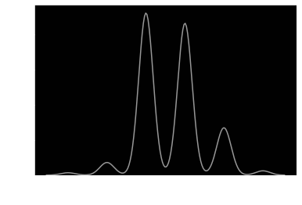
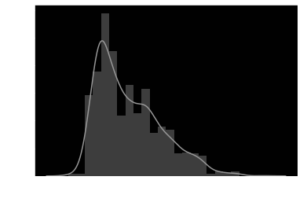
DATA ANALYSIS
KDE Plot: It is a method for visualizing the distribution of observations in a dataset.
Dist Plot: A Distplot depicts the variation in the data distribution.

Slide 10
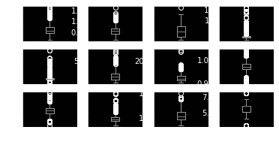
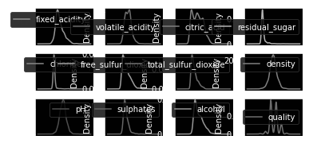
DATA ANALYSIS
Box Plot: It allows for users to determine where the majority of the points land at a glance.
Density Plot: It uses a kernel density estimate to show the probability density function of the variable.

Slide 11
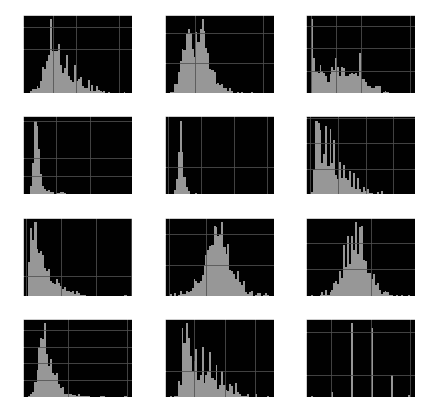
Histogram plot: A histogram is a graph showing frequency distributions. It is a graph showing the number of observations within each given interval.

Slide 12
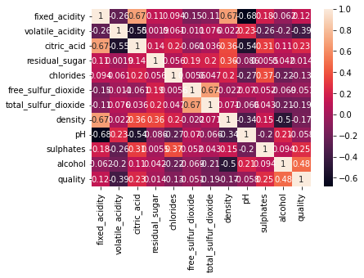
Heatmap: A heatmap is a graphical representation of data where each value of a matrix is represented as a color.

Slide 13
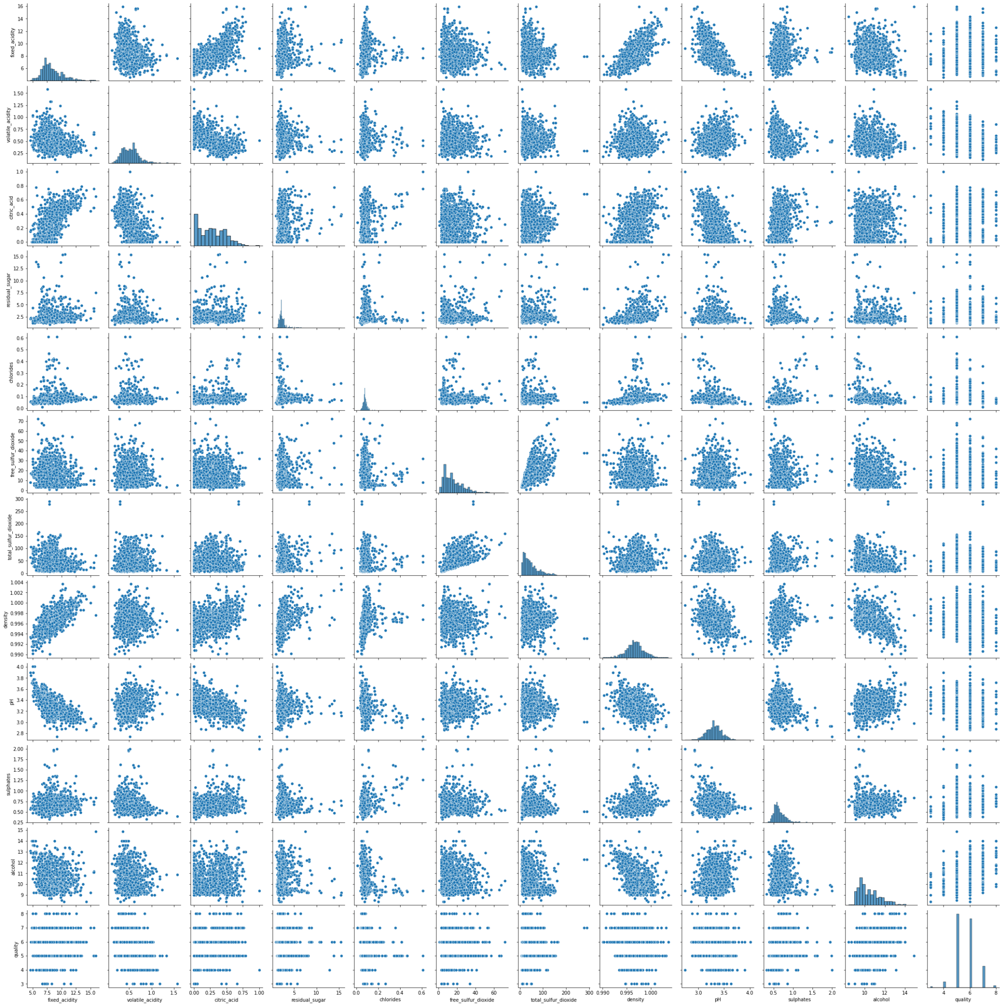
Pair plot: A pairs plot allows us to see both distribution of single variables and relationships between two variables.

Slide 14
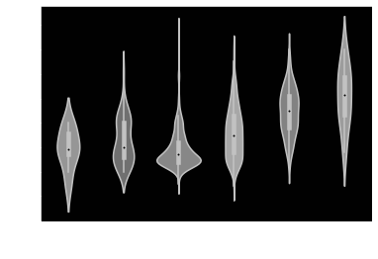
Violin plot: A violin plot is a statistical representation of numerical data. It is similar to a box plot, with the addition of a rotated kernel density plot on each side.

Slide 15
FEATURE SELECTION
We created a column named good quality which would show 1 for quality score greater than 7 otherwise 0.
Then we used value_count() function to see proportion of good quality wines vs bad quality wines.
The number of good quality wines came out to be 217 whereas the number of bad quality wines came out to be 1382.
value_count() returns a Series containing counts of unique values. The resulting object will be in descending order so that the first element is the most frequently-occurring element. Excludes NA values by default.

Slide 16
SPLITTING DATASET
Test train split is a common technique used in machine learning to evaluate the performance of a model on an independent dataset. The process involves splitting a dataset into two subsets: one for training the model and another for testing its performance.
Load the dataset: Load the dataset you want to work with into memory.
Split the dataset: Split the dataset into two subsets, one for training and one for testing. Typically, a random split of 70/30 is used, where 70% of training and 30% for testing.
Train the model: Train your machine learning model on the training dataset. This involves selecting a model, specifying features and labels, and fitting the model to the training data.
Test the model: Test the performance of the model on the test dataset. This involves making predictions on the test data and comparing them to the true labels. You can use a variety of metrics to evaluate the performance of the model, such as accuracy, precision, recall etc.

Slide 17
MODELS
LOGISTIC REGRESSION
Logistic regression predicts the output of a categorical dependent variable. Therefore the outcome must be a categorical or discrete value. It can be either Yes or No, 0 or 1, true or False, etc. but instead of giving the exact value as 0 and 1, it gives the probabilistic values which lie between 0 and 1.
We applied logistic regression in the dataset and the accuracy score of the model came out to be 0.86875.
We also applied the confusion_matrix() for Y_test, Y_pred.
The confusion matrix is a matrix used to determine the performance of the classification models for a given set of test data. It can only be determined if the true values for test data are known.

Slide 18
KNN
Then we applied the KNN to evaluate accuracy score and the accuracy score came out be 0.8729166666666667.
K-NN algorithm assumes the similarity between the new case and available cases and put the new case into the category that is most similar to the available categories.
K-NN algorithm stores all the available data and classifies a new data point based on the similarity. It is mostly used for the Classification problems.
K-NN is a non-parametric algorithm, which means it does not make any assumption on underlying data. It is also called a lazy learner algorithm because it does not learn from the training set immediately instead it stores the dataset and at the time of classification, it performs an action on the dataset.

Slide 19
SVC
SVC, or Support Vector Classifier, is a supervised machine learning algorithm typically used for classification tasks.
SVC works by mapping data points to a high-dimensional space and then finding the optimal hyperplane that divides the data into two classes.
We applied SVC and the accuracy of the model came out to be 0.86875.

Slide 20
Decision Tree
When we applied decision tree the accuracy of the model came out to be 0.8645833333333334.
A decision tree is a graphical representation of a decision-making process that uses a tree-like model of decisions and their possible consequences. It is a popular tool in machine learning for decision analysis, classification, and regression analysis.
The decision tree consists of nodes that represent decision points and branches that represent the possible outcomes or consequences of those decisions. The decision points can be based on various attributes or variables, and the outcomes can be discrete or continuous values.

Slide 21
Gaussian NB
Gaussian Naive Bayes (GNB) is a classification technique used in Machine Learning based on the probabilistic approach and Gaussian distribution. Gaussian Naive Bayes assumes that each parameter (also called features or predictors) has an independent capacity of predicting the output variable.
By applying Gaussian Naive Bayes, the accuracy of the model came out to be 0.8333333333333334.

Slide 22
Random Forest
Random Forest is a classifier that contains a number of decision trees on various subsets of the given dataset and takes the average to improve the predictive accuracy of that dataset. Instead of relying on one decision tree, the random forest takes the prediction from each tree and based on the majority votes of predictions, and it predicts the final output.
The greater number of trees in the forest leads to higher accuracy and prevents the problem of overfitting.
The accuracy of this model came out to be 0.89375.

Slide 23
XGboost
XGBoost, which stands for Extreme Gradient Boosting, is a scalable, distributed gradient-boosted decision tree (GBDT) machine learning library. It provides parallel tree boosting and is the leading machine learning library for regression, classification, and ranking problems.
The accuracy of the model using this algorithm came out to be 0.8916666666666667.

Slide 24
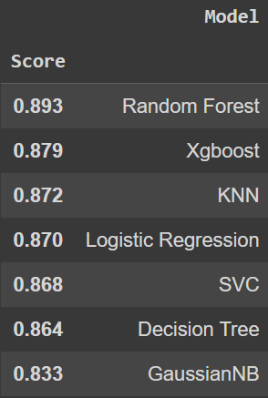
MODEL COMPARISON
After sorting the accuracy of all the algorithms used for modelling, random forest came out the best out of all with an accuracy of 0.893.

Slide 25

APPLICATION
We did certain predictions using an assumption that 0 is a bad quality wine and 1 is good quality wine.
We took input of model name and certain variables and found the score which predicted whether the wine is good or bad.

Slide 26
THANK YOU

